Slide 1
20XD14 -Problem Solving and C Programming
Control Statements in C

Slide 2
Outline
Control statements
Selection/Branching
  Conditional
    If
    If else
    Nested if
    else if ladder
  Unconditional
    go to
    break
    continue
    return
Iteration/Looping
    for
    while
    do – while

Slide 3

Control Statements
The C programs presented until now follows a sequential flow of execution of statements
  Statements in a program are normally executed one after another until the last statement completes
  A C application begins executing with the first line of the main() function and proceeds statement by statement until it gets to the end of the main() function
Compound Statement a group of statements bracketed by { and } that are executed sequentially

Slide 4
Control Statements
Transfer of Control / Flow of control
  The order in which statements are executed in a running program
Control statements / structures control the flow of execution in a program or function
The C control structures enable to combine individual instructions into a single logical unit with one entry point and one exit point

Slide 5
Control Statements
Instructions are organized into three kinds of control structures to control execution flow
  Sequence
  Selection, and
  Repetition
Sequential Programming
  Normally, statements in a program are executed one after the other in the order in which they’re written
  The most straightforward control structure
  A list of what to do, step by step
  Example
    Addition of two numbers

Slide 6
Control Statements
Selection in Programming
  Some problem solutions require steps with two or more alternative courses of action
  A selection control structure chooses which alternative to execute
  Often programmed using if statements (simple if, if-else, nested if and else if ladder), or switch-case statement
  Allow different sets of instructions to be executed depending on the outcome of a logical test ‒ Whether TRUE or FALSE - Branching
For example: To Pack my bag for work
  Pack my PC
  Pack my money
  If it's raining
    Pack my coat

Slide 7
Control Statements
Repetition in Programming: (Also called as Iteration)
  Some applications may also require that a set of instructions be executed repeatedly, possibly again based on some condition - Looping
  Typically programmed using code such as while, do-while and for statements
  Repetition Vs Selection statements
    In selection, the condition is tested once
    In repetition, the condition is tested a number of times, every time the program decides whether to loop or not

Slide 8
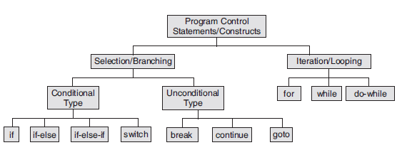
Control Statements in C

Slide 9
Conditional Branching
C provides three types of selection structures in the form of statements
  Single selection statement - if statement
    It selects or ignores a single action
  Two-way or double-selection statement - if…else statement
    It selects between two different actions
  Multi-way or Multiple-selection statement - else if ladder and switch statement

Slide 10

The if Selection Statement
Selection statements are used to choose among alternative courses of action.
For example
  Suppose the passing grade on an exam is 60.
The pseudocode statement determines whether the condition “student’s grade is greater than or equal to 60” is true or false.
If the condition is true, then “Passed” is printed, and the next pseudocode statement in order is “performed” (remember that pseudocode isn’t a real programming language).
If the condition is false, the printing is ignored, and the next pseudocode statement in order is performed.

Slide 11
The if Selection Statement
The general form of the if statement
if (condition/expression)
statement;
if (condition/expression)
{
statement sequence;
}
if - keyword
expression - constant or variable or relational or arithmetic or logical expression. Expression evaluates to TRUE(1) or FALSE (0)
statement - may either be a single statement or a block of statements
If expression is true (nonzero), statement is executed. If expression is false, statement is ignored
Note:
If a block contains a single statement, the braces can be deleted

Slide 12
How do we specify the expressions/conditions?
Using relational operators
  Four relation operators: <=, >, <, >=
  Two equality operators: ==, !=
Using logical operators / connectives
  Two logical connectives: &&, | |
  Unary negation operator: !
The conditions evaluate to
  Zero ‒ Indicates FALSE
  Non-zero ‒ Indicates TRUE
  Typically the condition TRUE is
  represented by the value 1
Examples
  count <= 100
  (math+phys+chem)/3 >= 60
  (sex==’M’) && (age>=21)
  (marks>=80) && (marks <90)
  (balance>5000)|| (no_of_trans>25)
  !(grade==‘A’)
  !((x>20) && (y<16))

Slide 13
Confusing Equality (==) and Assignment (=) Operators
Dangerous error
  Does not ordinarily cause syntax errors
  Any expression that produces a value can be used in control structures
  Nonzero values are true, zero values are false
  Example
  if (payCode = = 4)
  printf(ʺYou get a bonus!\nʺ);
  if (payCode = 4)
  printf(ʺYou get a bonus!\nʺ);

Slide 14
Examples
if (10<20)
{ a = b + c;
printf (ʺ%dʺ, a);
}
if ((a>b) && (x=10)) { …….… }
if (1) { ……………… }
if (0) { ……………… }
if (-1) {………………..}
if (a+b) {………………}

Slide 15
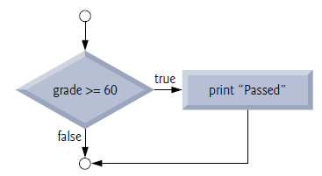
The if Selection Statement
The preceding pseudocode If statement may be written in C as
if ( grade >= 60 )
puts( "Passed" );
if ( grade >= 60 ) {
puts( "Passed" );
} // end if
The second line of this selection statement is indented. Such indentation is optional, but it’s highly recommended, as it helps emphasize the inherent structure of structured programs

Slide 16
The if Selection Statement
Note : Never place a semicolon after an expression in an if statement
#include<stdio.h>
int main() {
int grade=50;
if(grade>=60) ;
puts(“Pass");
}
In-class Exercise
  Write a program that will ask for a price. If the price is greater than 1000, compute a 10% discount from the original price. Display the computed discount.
#include<stdio.h>
int main() {
int grade=50;
if(grade>=60)
puts(“Pass");
puts(“Congrats”);
}
#include<stdio.h>
int main() {
int grade=70;
if(grade>=60)
{ puts(“Pass");
puts(“\nCongrats”);
}
}
Output : Pass
Output : Congrats
Output : Pass
Congrats

Slide 17
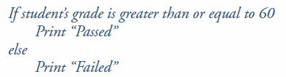
The if…else Selection Statement
The if selection statement performs an indicated action only when the condition is true; otherwise the action is skipped.
The if…else selection statement allows you to specify that different actions are to be performed when the condition is true and when it’s false
For example, the pseudocode statement
Prints Passed if the student’s grade is greater than or equal to 60 and Failed if the student’s grade is less than 60. In either case, after printing occurs, the next pseudocode statement in sequence is “performed”

Slide 18

The if…else Selection Statement
The general form of if…else statement is
if (condition/expression)
statement_1;
else
statement_2;
If and else - keywords
expression - constant or variable or relational or arithmetic or logical expression. Expression evaluates to TRUE(1) or FALSE (0)
statement - may either be a single statement or a block of statements
If expression is true (nonzero), statement1/ statement_sequence1 is executed. If expression is false, statement 2 / statement_sequence1 is executed (else block)
if (condition/expression) {
statement_sequence1;
}
else {
statement_sequence 2;
}
Note: If a block contains a single statement, the braces can be deleted

Slide 19
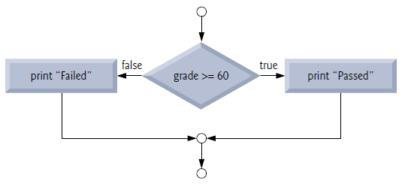
The if…else Selection Statement
The preceding pseudocode If…else statement may be written in C as
if ( grade >= 60 ) {
puts( "Passed" );
} // end if
else {
puts( "Failed" );
} // end else
if ( grade >= 60 )
puts( "Passed" );
else
puts( "Failed" );
Note:
Only the code associated with the if or the code that is associated with the else executes, never both

Slide 20
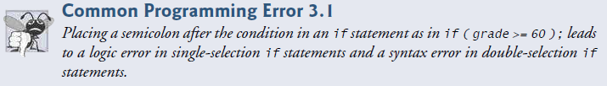
The if…else Selection Statement
Note: Never place a semicolon after an expression in an if…else statement
#include<stdio.h>
int main() {
int grade=66;
if ( grade >= 60 );
puts( "Passed" );
else
puts( "Failed" );
}
error: 'else' without a previous 'if'

Slide 21
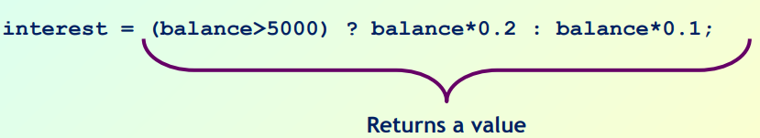
The if…else Selection Statement
C provides the conditional operator (?:), which is closely related to the if…else statement
The conditional operator is C’s only ternary operator—it takes three operands
These together with the conditional operator form a conditional expression.
condition ? Expression1 : Expression2;
The first operand is a condition. The second operand is the value for the entire conditional expression if the condition is true and the third operand is the value for the entire conditional expression if the condition is false
puts( grade >= 60 ? "Passed" : "Failed" );
grade >= 60 ? puts( "Passed" ) : puts( "Failed" );

Slide 22

The if…else Selection Statement
Conditional operators can be used in places where if…else statements cannot, including expressions and arguments to functions (like printf)
bool y = (x == 42) ? true : false;
bool y; if (x == 42) {y = true;} else {y = false;}
int a = (b == 2) ? x1 : x2;
#include<stdio.h>
int main()
{ int b=10, c=20, a;
printf(“a =%d", a=(b>c) ? 100 : 200);
}

Slide 23
Nested if …else Statement
If statement containing another if statement is known as nested if statement
If statement may be nested as deeply as you need to nest it
Syntax 1
Syntax 2
if(condition1/expression1)
if(condition2/expression2)
statement1;
else
statement2;
else
if(condition3/expression3)
statement3;
else
statement4;
if(condition1/expression1)
if(condition2/expression2)
statement1;
else
statement2;
else
statement3;

Slide 24
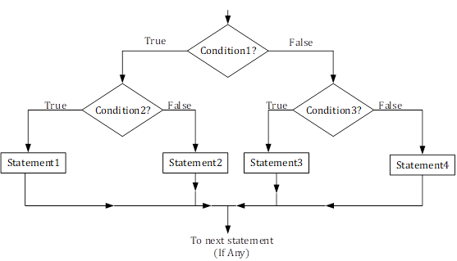
Nested if…else Statement

Slide 25
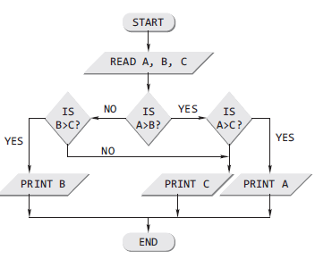
Nested if…else Statement
#include <stdio.h>
int main ()
{ int a, b, c, big;
printf ("Enter three numbers");
scanf ("%d %d %d", &a, &b, &c);
if (a > b)
if (a > c)
big = a;
else
big = c;
else if (b > c)
big = b;
else
big = c;
printf ("Largest of %d, %d & %d = %d", a,b,c,big);
}

Slide 26
Nested if…else Statement
Nested if is difficult to understand if there are more than 3 alternatives
Example
In a competitive exam a student getting more than 90 in Grade 1 exam only can appear in Grade 2 exam. Otherwise he has to redo it. If he gets more than 90 in Grade 2, then only he is allowed to write Grade 3 exam. If he clears Grade 3 exam he is declared pass. If he does not clear Grade 3 he has to redo Grade 3 exam

Slide 27
Nested if…else Statement
#include <stdio.h>
int main ()
{ int grade1,grade2,grade3;
printf ("Enter Grade 1 marks\n");
scanf ("%d ", &grade1);
if (grade1 > 90)
{ printf ("Enter Grade 2 marks\n");
scanf ("%d ", &grade2);
if (grade2 > 90)
{ printf ("Enter Grade 3 marks\n");
scanf ("%d ", &grade3);
if (grade3 > 90)
printf(“Performed well in Grade 3 too”);
else
printf(“Redo Grade 3”);
}
else
printf(“Redo Grade 2”);
}
else
printf (" Redo Grade 1");
}

Slide 28
Nested if...else Statements (else if ladder)
Nested if…else statements test for multiple cases by placing if…else statements inside if…else statements
ie., It is possible to nest if-else statements, one within another
For example
The following pseudocode statement will print
  A for exam grades greater than or equal to 90
  B for grades greater than or equal to 80 (but less than 90)
  C for grades greater than or equal to 70 (but less than 80)
  D for grades greater than or equal to 60 (but less than 70) and
  F for all other grades

Slide 29
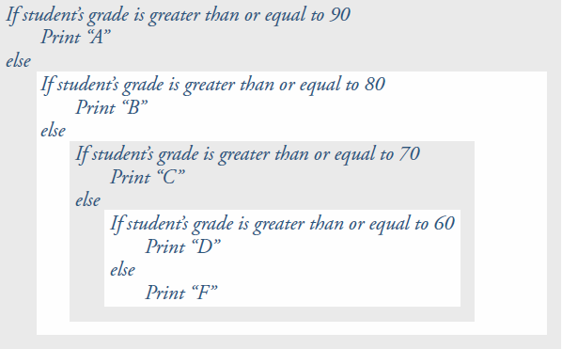
Nested if...else Statements

Slide 30
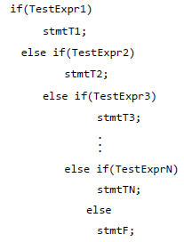
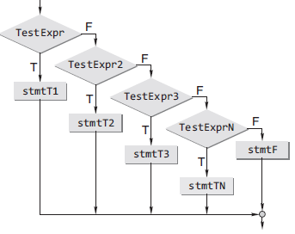
Nested if...else Statements
General form

Slide 31
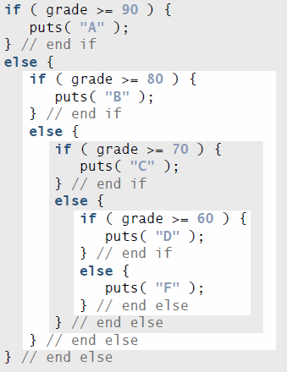
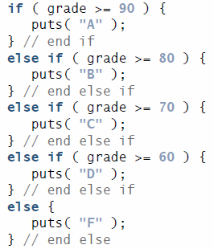
Nested if...else Statements
This pseudocode may be written in C as

Slide 32

Nested if...else Statements
It is possible to nest if-else statements, one within another
All if statements may not be having the “else” part
Confusion??
Rule to be remembered
  An “else” clause is associated with the closest preceding unmatched “if”

Slide 33
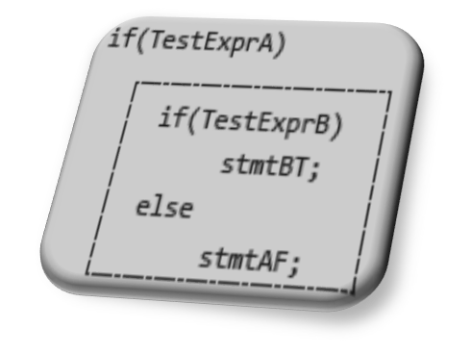
Dangling else Problem
This classic problem occurs when there is no matching else for each if. To avoid this problem, the simple C rule is that always pair an else to the most recent unpaired if in the current block
Consider the illustration shown here
The else is automatically paired with the closest if. But, it may be needed to associate an else with the outer if also

Slide 34
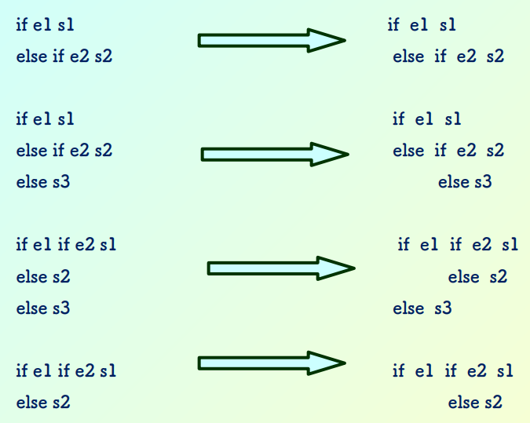
Nested if...else Statements

Slide 35
Nested if...else Statements
Dangling else problem
  When nested ifs are used, the problem of dangling else should be addressed
  For example, consider
    If (testscore >=50)
    if (testscore >90)
    printf (“You got an A Grade”);
    else
    printf(“fail”);
Indentation imply else is meant to be paired with outer if, but it pairs with inner if

Slide 36
Nested if...else Statements
Solution to Dangling Else
  Enclose inner if by braces as shown in order to avoid dangling else
    If (testscore >=50) {
    if (testscore >90)
    printf (“You got an A Grade”);
    else
    printf(“test score is between 50 to 90”);
    }
    else
    printf(“fail”);
It is safer to enclose the statement(s) within if block by braces to avoid dangling else

Slide 37
Nested if...else Statements
if e1 s1 if e1 s1
else if e2 s2 else { if e2 s2 }
if e1 s1 if e1 s1
else if e2 s2 else { if e2 s2
else s3 else s3 }
if e1 if e2 s1 if e1 { if e2 s1
else s2 else s2 }
else s3 else s3

Slide 38
Nested if...else Statements
Avoiding the dangling else problem
Null statement
if (exp1)
if (exp2)
stmta
else
;
else
stmtb
Compound statement
if (exp1) {
if (exp2)
stmta
}
else
stmtb

Slide 39
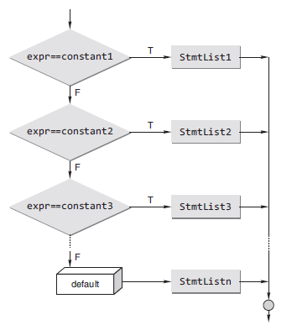
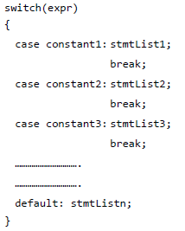
The switch Statement
C provides the switch multiple-selection statement to handle decision making
Syntax

Slide 40
The switch Statement
switch, case, break and default - Keywords
switch is followed by an expression in parentheses - controlling expression
The value of this expression is compared with each of the case labels
The switch statement is different from all other control statements in that braces are not required around multiple actions in a case of a switch
In switch statement, each individual case can test only a constant integral expression
  i.e., any combination of character constants and integer constants that evaluates to a constant integer value

Slide 41
The switch Statement
The switch-case selection statement has the switch statement with an expression and number of case definitions with their constants.
Only integer and single character constants can be used as case constants
Execution starts from the case whose constant matches with the value of switch expression
If the value of switch expression doesn’t match with any of the case constants then the default case is executed
break - statement is used to execute only a single case out of the total structure
Defining the default case in switch-case control structure is optional

Slide 42
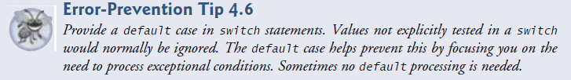


The switch Statement

Slide 43
The switch Statement
Rules for switch statement
The expression provided in the switch should result in a constant value otherwise it would not be valid
  Expression in switch must be integral (integer or character) expression or variable or constants, floating point values are not allowed
Values for 'case' must be integer or character constants, not floating point constant, you cannot use ranges in case
The order of the 'case' statements is unimportant, the default clause may occur any where (convention places it last)
If no break statement, the subsequent cases following the true case are also executed
No two case labels can have the same value
Two case labels can be associated with same statement
A switch statement can be nested. In such cases, case or default labels associate with the closest switch statement that encloses them
A switch…case statement can be always written using else if. But the converse is not true

Slide 44
The switch Statement
/* Determine life expectancy of a standard light bulb */
#include <stdio.h>
int main()
{ int watts;
scanf(“%d”, &watts);
switch (watts) {
case 25:
life = 2500;
break;
case 40:
case 60:
life = 1000;
break;
case 75:
case 100:
life = 750;
break;
default:
life = 0;
} }
/* Determine whether a given number is odd or even
#include <stdio.h>
int main()
{
int n;
printf(“\n Enter the number:”);
scanf(“%d”, &n);
switch(n%2)
{
case 0: printf(“\n EVEN”);
break;
case 1: printf(“\n ODD”);
break;
}
}

Slide 45
The switch Statement
#include<stdio.h>
int main()
{
int value1, value2;
char operator;
printf(“Type in your expression. \n”);
scanf(“%d %c %d ”,&value1,&operator,&value2);
switch(operator)
{
case ‘+’:
printf(“%d \n”, value1 + value2);
break;
case ‘-’:
printf(“%d \n”, value1 - value2);
break;
case ‘*’:
printf(“%d \n”, value1 * value2);
break;
case ‘/’:
if(value2 == 0)
printf(“division by zero”);
else
printf(“%d \n”, value1 / value2);
break;
default:
printf(“Unknown Operator \n”);
break;
}
return 0;
}

Slide 46
The switch Statement
#include <stdio.h>
int main()
{
char c;
printf(“Enter a character: “);
scanf(“%c”, &c);
switch(c)
{
case ‘a’:
case ‘A’:
case ‘e’:
case ‘E’:
case ‘i’:
case ‘I’:
case ‘o’:
case ‘O’:
case ‘u’:
case ‘U’:
printf(“%c is always a vowel!\n”, c);
break;
case ‘y’:
case ‘Y’:
printf(“%c is sometimes a vowel!\n”, c);
break;
default:
printf(“%c is not a vowel!\n”, c);
break;
}
return 0;
}

Slide 47
Switch Vs else if Statements
The switch differs from the else-if in that switch can test only for equality, whereas the if conditional expression can be of a test expression involving any type of relational operators and/or logical operators. A switch statement is usually more efficient than nested ifs
The switch statement can always be replaced with a series of else-if statements. One may only use switch and case statements if an expression is required to check against a finite amount of constant, integral, or character values

Slide 48
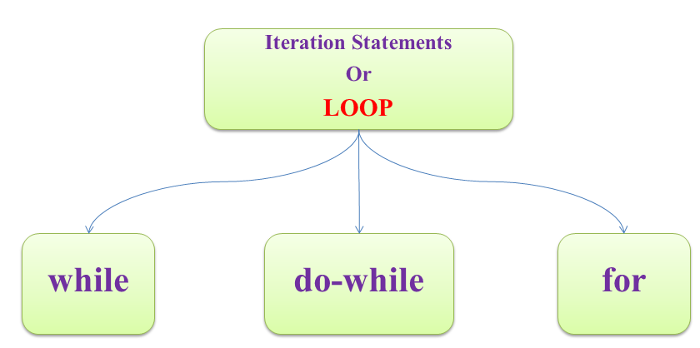
Iterative/Looping Statements in C
An iteration statement (also called as repetition statement or loop) allows you to specify that an action is to be repeated while some condition remains true
Each execution of the group of statements is called an iteration of the loop
Three Looping statements in C

Slide 49
Iterative/Looping Statements in C
Loop is a group of instructions the computer executes repeatedly while some loop-continuation condition remains true
Two means of iteration
  1. Counter-controlled iteration
  2. Sentinel-controlled iteration
Counter-controlled iteration - also called as definite iteration because we know in advance exactly how many times the loop will be executed
  In counter-controlled iteration, a control variable is used to count the number of iterations
  The control variable is incremented (usually by 1) each time the group of instructions is performed
  When the value of the control variable indicates that the correct number of iterations has been performed, the loop terminates and execution continues with the statement after the iteration statement

Slide 50
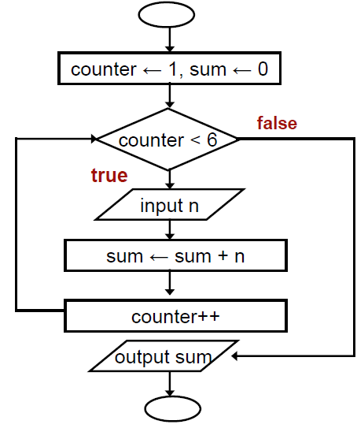

Iterative/Looping Statements in C
  Counter-controlled Loop
Read 5 integers and
display the value of their
summation

Slide 51
Iterative/Looping Statements in C
Sentinel-controlled iteration - also called as indefinite iteration because it’s not known in advance how many times the loop will be executed
  Sentinel values are used to control iteration when:
    1. The precise number of iterations isn’t known in advance, and
    2. The loop includes statements that obtain data each time the loop is
    performed
The sentinel value indicates “end of data.” The sentinel is entered after all regular data items have been supplied to the program
Sentinels must be distinct from regular data items

Slide 52
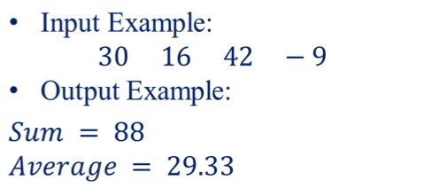

Iterative/Looping Statements in C
Example - Sentinel-controlled iteration
Receive a number of positive integers and display the summation and average of these integers
A negative or zero input indicates the end of input process
Input: A set of integers
ending with a
negative integer or a zero
Output: Summation and
Average of these integers
Sentinel
Value

Slide 53
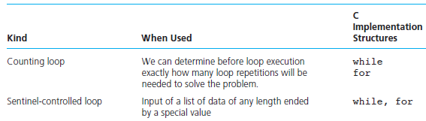

Iterative/Looping Statements in C
Comparison of Loop kinds

Slide 54
Iterative/Looping Statements in C
Three parts of a loop
    Initialization – done only once
    Condition – checked during each iteration until evaluates to false
    Iteration(updating of loop control variable) – updates the value of control variable
Two types of Loops
  Pre-test Loops – while, for
    In each iteration loop condition is tested, if it is true loop statements are executed otherwise the loop is terminated
  Post-test Loops – do…while
    The first iteration is executed without checking the loop condition. Then the loop condition is tested. If it is true next iteration starts, otherwise the loop is terminated

Slide 55
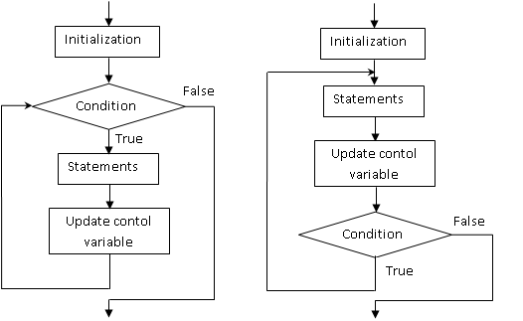
Iterative/Looping Statements in C
(a) Pre-test Loops (b) Post-test Loops

Slide 56
Iterative/Looping Statements in C
Entry Controlled / Pretest Loop (while, for) | Exit Controlled / Post-test Loop (do-while)
No of times of Execution Initialization 1 Loop condition test n+1 Updating of control variable n Body of loop(Max) n Body of loop(Min) 0 | No of times of Execution Initialization 1 Loop condition test n Updating of control variable n Body of loop(Max) n Body of loop(Min) 1

Slide 57
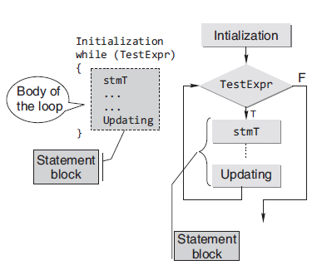
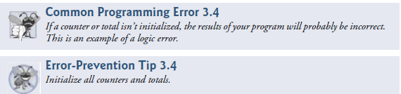
Iterative/Looping Statements in C
The while Statement
    while statement is a pre-test loop. The loop body will not be executed if the loop-control expression evaluates to false (zero)
Syntax
Initialization (1)
while ( expression (2) )
{ statements;
Update control variable(3)
}
statement x;

Slide 58

Iterative/Looping Statements in C
Initially, i=1
I iteration
1<=5 (true)
print 1
i=1+1=2
II iteration
2<=5 (true)
print 2
i=2+1 = 3
III iteration
3<=5(true)
print 3
i= 3+1 =4
IV iteration
4<=5 (true)
print 4
i=4+1=5
V iteration
5<=5 (true)
print 5
i=5+1 = 6
VI iteration
6<=5 (false)
Example 1:
Counter- controlled
#include<stdio.h>
int main()
{
int i=1;
while (i<=5)
{
printf(“%d”, i);
i++;
}
}
Output:
1 2 3 4 5
Initialization :1
Loop condition test :n+1
Update of control variable :n

Slide 59
Iterative/Looping Statements in C
Example 2
#include<stdio.h>
int main()
{
int i=1;
while (i<=5)
printf(“%d”, i);
i++;
}
Output : 1 1 1 1 1 1 1 …
(infinite number of times)
#include<stdio.h>
int main()
{
int i=1;
while(++i<=5);
printf("%d",i);
return 0;
}
Output : 6

Slide 60
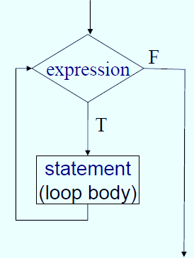
Iterative/Looping Statements in C
Example 3
#include<stdio.h>
int main()
{
int i=1;
while (1)
{
if (i<=5)
printf(“%d”, i);
else
break;
i++;
}
}
Note : break can be used to terminate the while loop

Slide 61
Iterative/Looping Statements in C
Example 4
#include<stdio.h>
int main()
{
while( )
printf("Hello world");
return 0;
}
Error : expected expression before ')' token
#include<stdio.h>
int main()
{
int i=1;
while(1)
{
printf("\t%d",i++);
if(i==5)
goto abc;
}
abc:
return 0;
}
Output : 1 2 3 4

Slide 62
Iterative/Looping Statements in C
Example 5 : Program to print a horizontal row of 10 asterisks
Version 1
#include <stdio.h>
int main()
{
int times = 0;
while (times < 10)
{
printf( “*”);
times++;
}
return 0;
}
Version 2
#include <stdio.h>
int main()
{
int times = 1;
while (times <= 10)
{
printf( “*”);
times++;
}
return 0;
}
Version 3
#include <stdio.h>
int main()
{
int times = 10;
while (times > 0)
{
printf(“*”);
times--;
}
return 0;
}
output : **********

Slide 63
Iterative/Looping Statements in C
Example 6 : Sentinel-controlled - Compute the average given the grades
#include <stdio.h>
int main()
{
unsigned int counter=1;
int grade;
int total = 0;
float average;
printf( "Enter grade, -1 to end: " );
scanf( "%d", &grade );
// loop while sentinel value not yet
read from user
while ( grade != -1) {
total = total + grade;
counter = counter + 1;
printf( "Enter grade, -1 to end: " );
scanf( "%d", &grade ); }
if ( counter != 0) {
average = (float) total / counter;
printf( "Class average is \n", average);
}
else {
puts( "No grades were entered" );
}
}

Slide 64
Iterative/Looping Statements in C
#include<stdio.h>
int main()
{
int age;
char ch=‘y’;
while (ch==‘y’ || ch==‘Y’)
{
printf(“ Enter you age”);
scanf(“%d”, &age);
if (age>17)
printf(“Eligible”);
else
printf(“Not eligible”);
printf(“Do u want to continue?(y - yes/n-no)”);
scanf(“%d”, &ch);
}
}

Slide 65
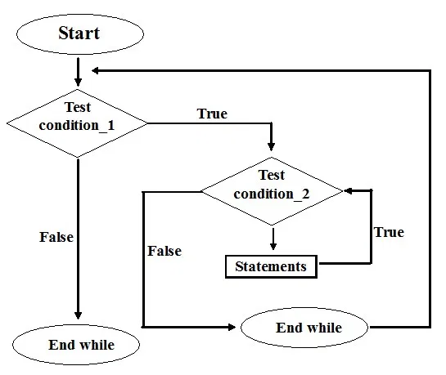

Iterative/Looping Statements in C
Nested while Loops
while(test_expression1)
{
statements;
while(test_expression2)
{
statements;
}
}

Slide 66
Iterative/Looping Statements in C
#include <stdio.h>
int main()
{
int i=1, j;
while (i <= 3)
{
j=1;
while (j <= i )
{
printf("%d ",j);
j++;
}
printf("\n");
i++;
}
return 0;
}
Output
1
1 2
1 2 3
Note:
For each iteration of outer loop, the inner loop is executed for i times

Slide 67
Iterative/Looping Statements in C
IV iteration – outer loop
4<=3 (false)
Initially, i=1
I iteration - outer loop
1<=3 (true)
j =1
I iteration – inner loop
1<=1 (true)
print 1
j=1+1=2
II iteration – inner loop
2<=1 (false)
i=1+1 =2
II iteration – outer loop
j =1
I iteration – inner loop
1<=2 (true)
print 1
j=1+1=2
II iteration – inner loop
2<=2 (true)
print 2
j=2+1 =3
III iteration – inner loop
3<=2 (false)
i=2+1=3
III iteration – outer loop
3<=3 (true)
j =1
I iteration – inner loop
1<=3 (true)
print 1
j=1+1=2
II iteration – inner loop
2<=3 (true)
print 2
j=2+1 =3
III iteration – inner loop
3<=3 (true)
print 3
j=3+1 =4
IV iteration – inner loop
4<=3 (false)
i=3+1 =4
#include <stdio.h>
int main()
{
int i=1, j;
while (i <= 3)
{
j=1;
while (j <= i )
{
printf("%d ",j);
j++;
}
printf("\n");
i++;
}
return 0;
}
Output
1
1 2
1 2 3

Slide 68
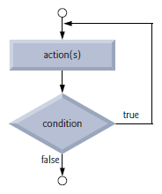
Iterative/Looping Statements in C
The do…while statement
  The do…while iteration statement is similar to the while statement
  In the while statement, the loop-continuation condition is tested at the beginning of the loop before the body of the loop is performed
  The do…while statement tests the loop-continuation condition after the loop body is performed. Therefore, the loop body will always execute at least once
  When a do…while terminates, execution continues with the statement after the while clause

Slide 69
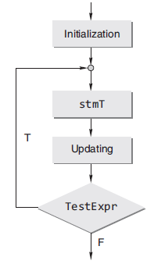
Iterative/Looping Statements in C
Syntax
    Initialization(1)
    do
    {
    statements;
    update control variable(3)
    } while(expression(2));
    statement x;
Execution proceeds as follows
The loop body is executed
Next, expression is evaluated
If expression is false, the do-while statement terminates and control passes to the next statement in the program. If expression is true (non-zero), the execution of statements in the loop body is repeated

Slide 70
Iterative/Looping Statements in C
Initially, i=1
I iteration
print 1
i=1+1=2
2<=5 (true)
II iteration
print 2
i=2+1 = 3
3<=5 (true)
III iteration
print 3
i= 3+1 =4
4<=5(true)
Example 1 : Counter-controlled
IV iteration
print 4
i=4+1=5
5<=5 (true)
V iteration
print 5
i=5+1 = 6
6<=5 (false)
#include<stdio.h>
int main()
{
int i=1;
do
{
printf(“%d”, i);
i++;
} while(i<=5);
}
Output:
1 2 3 4 5
Initialization :1
Loop condition test :n
Update of control variable :n

Slide 71
Iterative/Looping Statements in C
Example 2
#include <stdio.h>
int main()
{
unsigned int counter=0;
int grade;
int total = 0;
float average;
do
{
printf( "Enter grade, -1 to end: " );
scanf( "%d", &grade );
if (grade == -1)
break;
else
{ total = total + grade;
counter = counter + 1; }
} while (1) ;
if ( counter != 0) {
average = (float) total / counter;
printf( "Class average is \n", average);
}
else {
puts( "No grades were entered" );
}
}

Slide 72
Iterative/Looping Statements in C
#include<stdio.h>
int main()
{
int age;
char ch ;
do
{
scanf(“%d”, &age);
if (age>17)
printf(“Eligible”);
else
printf(“Not eligible”);
printf(“Do u want to continue?(y/n)”);
scanf(“%c”, &ch);
} while (ch== ‘y’ || ch==‘Y’);
}

Slide 73
Iterative/Looping Statements in C
Example 4
#include<stdio.h>
int main()
{
int x=5;
do
printf("\t%d",x--);
while (x);
return 0;
}
Output :
5 4 3 2 1
#include<stdio.h>
int main()
{
int x=5;
do
printf("\t%d",x--);
printf("Hai");
while (x);
return 0;
}
Error : expected 'while' before 'printf'
Note : { } - not needed for a single statement in the loop body

Slide 74
Iterative/Looping Statements in C
Example 5
#include<stdio.h>
int main()
{
int x=5;
do ;
printf("\t%d",x--);
while (x);
return 0;
}
Error : expected 'while' before
'printf'
#include<stdio.h>
int main()
{
int x=5;
do
printf("\t%d",x--);
while (x)
return 0;
}
Error : expected ';' before 'return'

Slide 75
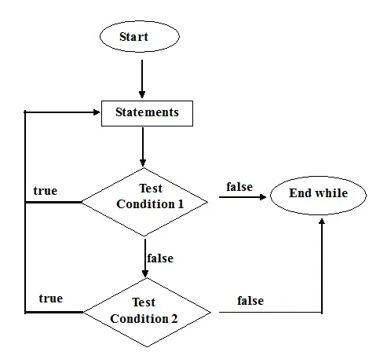
Iterative/Looping Statements in C
Example 6 – Nested do…while
Syntax
do {
do {
statements
} while(condition1);
statements
} while(condition2);

Slide 76
Iterative/Looping Statements in C
#include <stdio.h>
int main()
{
int i =1, j;
printf("Triangle number pattern\n");
do {
j=1;
do {
printf("%d",j);
j++;
} while(j<=i);
printf("\n");
i++;
} while(i<=3);
return 0;
}
Output :
1
12
123

Slide 77
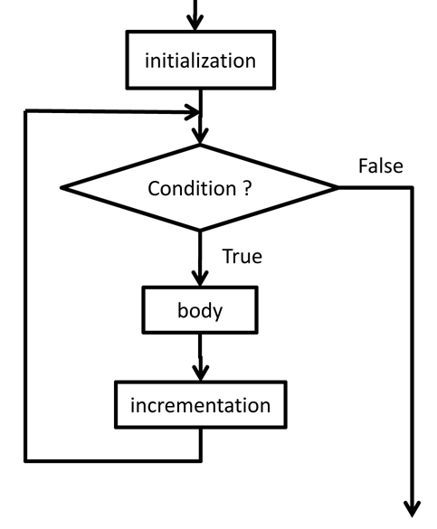

Iterative/Looping Statements in C
The for statement
If the number of times the loop is executed is known – use for
It lets you repeat a statement or compound statement a specified number of times
The body of for statement is executed zero or more times until an optional condition becomes false
Syntax
for ( initialization; condition ; update control variable)
{
statements;
}
statement x;

Slide 78
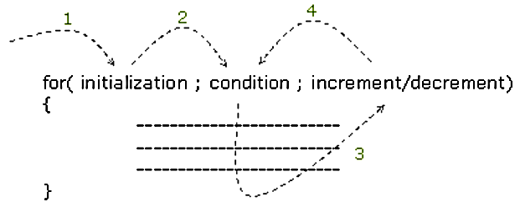
Iterative/Looping Statements in C
Execution of a for statement proceeds as follows
  1. Initialization is evaluated at the beginning of the loop
  2. If the condition evaluates to true(non-zero) the body of the loop is executed. Otherwise the control is transferred to the statement x following the loop body
  3. The control variable is updated at the end of each iteration
  4. Steps 2 and 3 are repeated

Slide 79
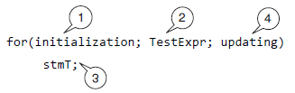
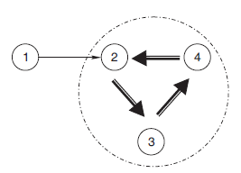
Iterative/Looping Statements in C

Slide 80
Iterative/Looping Statements in C
Printing 1 to 10 natural numbers
/* using while loop */
#include<stdio.h>
int main()
{
int i=1;
while(i<=10)
{
printf("\t%d",i);
i++;
}
return 0;
}
/* using for loop */
#include<stdio.h>
int main()
{
int i;
for(i=1;i<=10;i++)
printf("\t%d",i);
return 0;
}
Output : 1 2 3 4 5 6 7 8 9 10

Slide 81
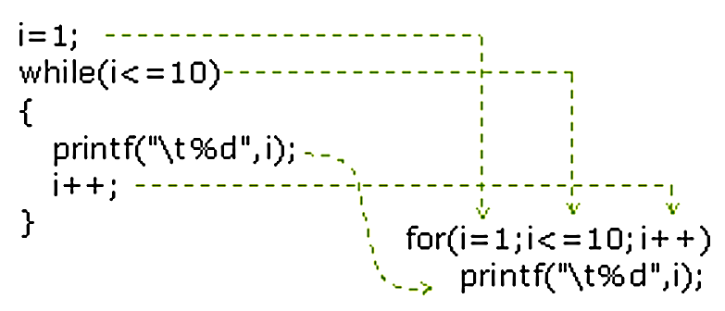
Iterative/Looping Statements in C
Converting while loop into for loop

Slide 82
Iterative/Looping Statements in C
Initially, i=1
I iteration
1<=5 (true)
print 1
i=1+1=2
II iteration
2<=5 (true)
print 2
i=2+1 = 3
III iteration
3<=5(true)
print 3
i= 3+1 =4
IV iteration
4<=5 (true)
print 4
i=4+1=5
V iteration
5<=5 (true)
print 5
i=5+1 = 6
VI iteration
6<=5 (false)
/* using for loop */
#include<stdio.h>
int main()
{
int i;
for(i=1; i<=5; i++)
printf("\t%d",i);
return 0;
}
Initialization :1
Loop condition test :n+1
Update of control variable :n

Slide 83
Iterative/Looping Statements in C
Note :
Initialization, condition, and control variable updation are optional
  Condition (if any) is evaluated. It is evaluated before each iteration.
  If condition is omitted, condition is considered true, a for statement without a condition terminates only when a break or return statement within the statement body is executed, or when a goto (to a labeled statement outside the for statement body) is executed.
A for statement also terminates when a break, goto, or return statement within the statement body is executed
A continue statement in a for loop causes loop-expression to be evaluated
When a break statement is executed inside for loop, loop-expression is not evaluated or executed
The statement for( ;; ); - is the customary way to produce an infinite loop which can only be exited with a break, goto, or return statement

Slide 84
Iterative/Looping Statements in C
Note :
The initialization, loop-continuation condition and increment can contain arithmetic expressions.
  For example, if x = 2 and y = 10, the statement
for (j = x; j <= 4 * x * y; j += y / x)
is equivalent to the statement
for (j = 2; j <= 80; j += 5)
The “increment” may be negative (in which case it’s really a decrement and the loop actually counts downward)
If the loop-continuation condition is initially false, the loop body does not execute. Instead, execution proceeds with the statement following the for statement
The control variable is frequently printed or used in calculations in the body of aloop, but it need not be. It’s common to use the control variable for controlling iteration while never mentioning it in the body of the loop

Slide 85
Iterative/Looping Statements in C
Examples Using the for Statement
int i, j, s;
  for (i = 1; i <= 100; ++i) // for (i = 0; i <100; ++i)
  for (i = 1; i <= 100; i++)
  for (i = 100; i >= 1; i--)
  for (i = 7; i <= 77; i += 7)
  for (i = 20; i >= 2; i -= 2)
  for (j = 2; j <= 17; j = j + 3)
  for (j = 44; j >= 0; j -= 11)
  for (s = 0,i = 1;i <= 10; i++)
  s = s + i;
  scanf("%d",&n);
  for (i = 1;i <= n; i++)

Slide 86
Iterative/Looping Statements in C
#include<stdio.h>
int main()
{
int i;
for( i=1; i<=5; )
printf("\t%d", i++);
return 0;
}
Output:
1 2 3 4 5
#include<stdio.h>
int main()
{
int sum=0,i=1;
for( ; i<=5; i++ )
sum = sum + i;
printf("Sum is : %d", sum);
return 0;
}
Output:
Sum is : 15

Slide 87
Iterative/Looping Statements in C
#include<stdio.h>
int main()
{
int i;
for( i=1; ; i++ )
printf("\t%d", i);
return 0;
}
Output:
1 2 3 …….
(infinite number of times)
#include<stdio.h>
int main()
{
for( ; ; )
printf("Hello World");
return 0;
}
Output:
Hello World …………
(infinite number of times)

Slide 88
Iterative/Looping Statements in C
#include<stdio.h>
int main()
{
int i;
for(i=1;i<=5;i++) ;
printf("%d", i);
return 0;
}
Output:
6
#include<stdio.h>
int main()
{
int sum, i;
for(sum=0,i=1; i<=10; sum+=i, i++) ;
printf("Sum : %d", sum);
return 0;
}
Output:
Sum : 55

Slide 89
Iterative/Looping Statements in C
#include<stdio.h>
int main()
{
int i=1, j=5;
while(j>=1)
{
printf("\n%d\t%d", i , j);
i++;
j--;
}
}
Output :
1 5
2 4
3 3
4 2
5 1
for(i=1,j=5; i<=5; i++, j--)
printf("\n%d\t%d", i , j);
#include<stdio.h>
int main()
{
int i, j;
for(i=1,j=5; i<=5, j>=1; printf("\n%d\t%d", i, j),i++,j--);
return 0;
}

Slide 90
Iterative/Looping Statements in C
Accept numbers until 0 and print the sum of them
#include<stdio.h>
int main()
{
int sum=0, n;
printf("Enter numbers, give 0 to stop:\n");
scanf("%d",&n);
do {
sum=sum+n;
scanf("%d",&n);
} while(n!=0);
printf("Sum : %d", sum);
}
Output :
Enter the numbers, give 0 to stop..
12
34
56
77
0
Sum of numbers 179
for( sum=0, scanf("%d",&n); n!=0; sum+=n, scanf("%d",&n) );
printf("Sum of numbers %d", sum);

Slide 91
Iterative/Looping Statements in C
Nested for statement
  For statement within another for
  When the dimension of data is more than 1, nested for loop is used
  example: Table of data, matrix
Syntax
  for ( initialization; condition 1; control variable updation)
  {
  for ( initialization; condition 2; control variable updation)
  {
  //body of the inner loop
  }
  }
  statement x;

Slide 92
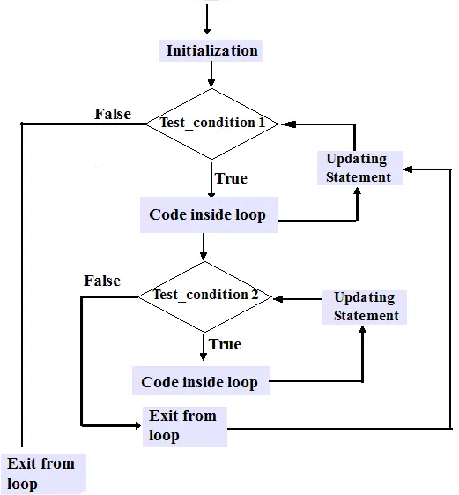
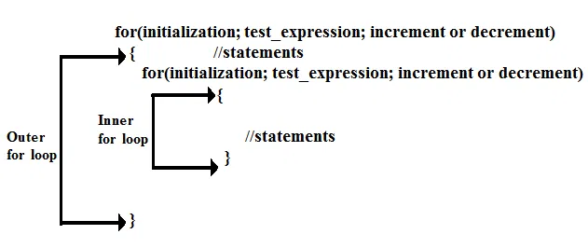
Iterative/Looping Statements in C

Slide 93
Iterative/Looping Statements in C
#include<stdio.h>
int main()
{
int i,j;
for(i=1; i<10; i++)
{
for(j=1; j<=i; j++)
{
printf(“%d”, j);
}
}
}
Output:
1
12
123
1234
12345
123456
1234567
12345678
123456789

Slide 94
Iterative/Looping Statements in C
Initially, i=1
I iteration - outer loop
1<=3 (true)
j =1
I iteration – inner loop
1<=1
print 1
j =1+1=2
II iteration – inner loop
2<=1 (false)
i=1+1 =2
II iteration – outer loop
2<=3 (true), j =1
I iteration – inner loop
1<=2
print 1
j =1+1=2
II iteration – inner loop
2<=2 (true)
print 2
j =2+1 =3
III iteration – inner loop
3<=2 (false)
i=2+1=3
III iteration – outer loop
3<=3 (true), j =1
I iteration – inner loop
1<=3
print 1
j =1+1=2
II iteration – inner loop
2<=3 (true)
print 2
j =2+1 =3
III iteration – inner loop
3<=3 (true)
print 3
j =3+1 =4
IV iteration – inner loop
4<=3 (false)
i=3+1 =4
IV iteration – outer loop
4<=3 (false)
#include<stdio.h>
int main()
{
int i,j;
for(i=1; i<= 3; i++)
{
for(j=1; j<=i; j++)
{
printf(“%d”, j);
}
}
}
Output:
1
12
123

Slide 95
When to Use Which Loop ?
If you know ( or can calculate ) how many iterations you need, then use a counter-controlled ( for ) loop
Otherwise, if it is important that the loop complete at least once before checking for the stopping condition, or if it is not possible or meaningful to check the stopping condition before the loop has executed at least once, then use a do-while loop
Otherwise use a while loop

Slide 96
Unconditional Control Transfer Statements in C
break
continue
goto
return

Slide 97
Unconditional Control Transfer Statements in C
The break statement
Used to terminate the loop in the middle of any iteration when a certain condition is satisfied
Sometimes while executing a loop it becomes desirable to quit the loop as soon as certain condition occurs
For example
  Consider searching a particular number in a set of 100 numbers as soon as the search number is found it is desirable to terminate the loop
The break statement allows us to accomplish this task

Slide 98
Unconditional Control Transfer Statements in C
The break statement terminates the execution of the nearest enclosing do, for, switch, or while statement in which it appears
Control passes to the statement that follows the terminated statement. ie., a break causes the innermost enclosing loop or switch to be exited immediately.
Syntax
break;
Note: Within nested statements, the break statement terminates only the do, for, switch, or while statement that contains it

Slide 99
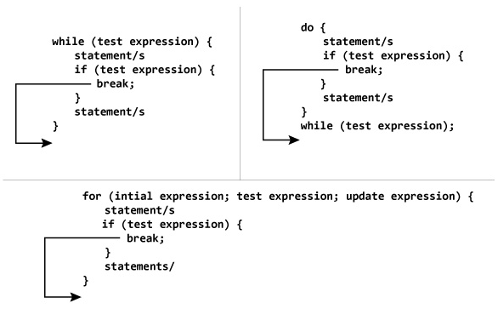
How does break statement work?

Slide 100
Unconditional Control Transfer Statements in C
#include<stdio.h>
int main()
{
int x=1;
while(1) /*infinite loop*/
{
if(x==5)
break;
printf("\t%d",x++);
}
return 0;
}
#include<stdio.h>
int main()
{
int x=1;
for ( ; ; )
{
if(x>5)
break;
printf("\t%d", x++);
}
return 0;
}
Output:
1 2 3 4 5

Slide 101
Unconditional Control Transfer Statements in C
#include <stdio.h>
int main() {
// nested for loops with break statement
// at inner loop
for (int i = 0; i < 5; i++)
{
for (int j = 1; j <= 10; j++)
{
if (j >= 3)
break;
else
printf("*");
}
printf("\n");
}
return 0;
}
Output:
***
***
***
***
***
Note: Within nested statements, the break statement terminates only the do, for, switch, or while statement that contains it

Slide 102
Unconditional Control Transfer Statements in C
The continue statement
The continue statement is used to bypass the remainder of the current pass through a loop
The loop does not terminate when a continue statement is encountered. Instead, the remaining loop statements are skipped and the computation proceeds directly to the next pass through the loop
The continue statement can be included within a while, do-while, for statement
Syntax
continue;

Slide 103
Unconditional Control Transfer Statements in C
The continue statement, when executed in a while, for or do…while statement, skips the remaining statements in that control statement’s body and performs the next iteration of the loop
In while and do…while statements, the loop-continuation test is evaluated immediately after the continue statement executes.
In the for statement, the increment expression executes, then the loop-continuation test is evaluated

Slide 104
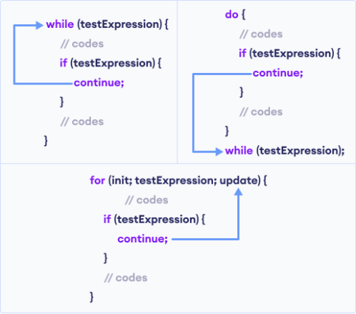
Unconditional Control Transfer Statements in C

Slide 105
Unconditional Control Transfer Statements in C
#include<stdio.h>
int main()
{
int x;
for(x=1;x<=10;x++)
{
if(x%2==1) /*checking for odd number */
continue;
printf("\t%d",x);
}
return 0;
}
#include<stdio.h>
int main()
{
int i;
for(i=1;i<=10;i++)
{
if(i%3!=0)
continue;
printf(“%d”, i);
}
}
Output: 3 6 9
Output:
2 4 6 8 10

Slide 106
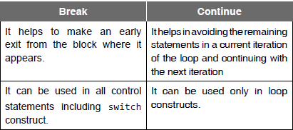
Unconditional Control Transfer Statements in C

Slide 107
Unconditional Control Transfer Statements in C
#include <stdio.h>
int main(void)
{
unsigned int x;
for (x = 1; x <= 10; ++x)
{
if (x == 5)
{ break;
}
printf("%u ", x);
}
printf("\nout of loop at x == %u\n", x);
}
Output: 1 2 3 4
out of loop at x == 5
#include <stdio.h>
int main(void)
{
unsigned int x;
for (x = 1; x <= 10; ++x)
{
if (x == 5)
{ continue;
}
printf("%u ", x);
}
}
Output:
1 2 3 4 6 7 8 9 10

Slide 108
Unconditional Control Transfer Statements in C
The goto Statement – an unconditional branch
The result of the goto statement is a change in the flow of control to the first statement after the label specified in the goto statement
Syntax
goto label;
…
label:
//block of statements
A label is an identifier followed by a colon
A label must appear in the same function as the goto statement that refers to it
It is good programming style to use the break, continue, and return statement in preference to goto whenever possible

Slide 109

Unconditional Control Transfer Statements in C
#include <stdio.h>
int main(void)
{
int count = 1;
start:
if (count > 10)
{
goto end;
}
printf("%d ", count);
++count;
goto start;
end :
return 0;
}
Output:
1 2 3 4 5 6 7 8 9 10

Slide 110
Unconditional Control Transfer Statements in C
#include <stdio.h>
int main()
{
int n, c;
long int f=1;
printf(“\n Enter the number:”);
scanf(“%d”,&n);
if(n<0)
goto end;
c=1;
loop:
f=f*c;
c++;
if(c<=n)
goto loop;
printf(“ FACTORIAL IS %ld”, f);
end:
return 0; }
#include <stdio.h>
int main()
{
int n, c;
long int f=1;
printf(“\n Enter the number:”);
scanf(“%d”,&n);
if(n<0)
goto end;
for(c=1; c<=n; c++)
f*=c;
printf(“\n FACTORIAL IS %ld”, f);
end:
return 0;
}

Slide 111

Unconditional Control Transfer Statements in C
#include<stdio.h>
int main()
{
int i, j;
for ( i = 0; i < 10; i++ )
{
printf( "Outer loop executing. i = %d\n", i );
for ( j = 0; j < 3; j++ )
{
printf( " Inner loop executing. j = %d\n", j );
if ( i == 5 )
goto stop;
}
}
/* This message does not print: */
printf( "Loop exited. i = %d\n", i );
stop:
printf_s( "Jumped to stop. i = %d\n", i );
}

